Slide 1
The Vancouver / Whistler Experience For 2

Slide 2
Vancouver…
1 of 4 hotels in Canada with AAA 5 Diamond Award in 2023
2 nights with breakfast
https://www.fairmontpacificrim.com/

Slide 3
Vancouver…
Dinner for Two
https://www.annalena.ca/

Slide 4
Vancouver…
Dinner for Two
https://www.burdockandco.com/

Slide 5
Whistler…
5 nights
#1 Ski Resort Hotel in North America and #1 Golf Resort in Canada
https://www.fairmont.com/whistler/

Slide 6
Two, 5-Day EDGE CARDS
Ski or ride any 5 days of the season at Whistler Blackcomb
https://www.whistlerblackcomb.com/Plan-Your-Trip/Lift-Access/Passes/5-Day-Edge-Card

Slide 7
Whistler…
Full Whistler Sightseeing Tour for 2
https://www.whistlervalleytours.com/sightseeing

Slide 8
Whistler…
Dinner for Two
https://www.fairmont.com/whistler/dining/grillroom/

Slide 9
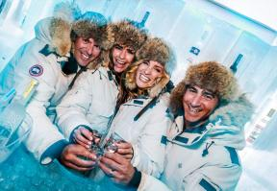
Tasting menu for two
A champagne sabering experience
Visit to the Grey Goose Ice Room
https://bearfootbistro.com/the-experience/

Slide 10
$200 Gift Certificate
https://www.wildbluerestaurant.com/
2024 Gold Medal Winner

Slide 11
Whistler…
Chef’s tasting menu for 2 with wine pairings
https://www.araxi.com/

Slide 12
Chef’s tasting menu for 2 with wine pairings
https://ilcaminetto.ca/

Slide 13
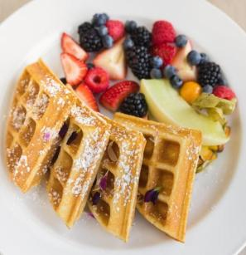
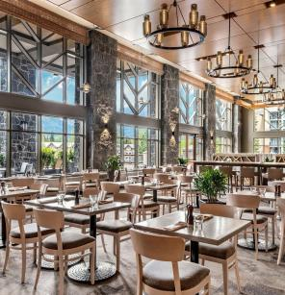
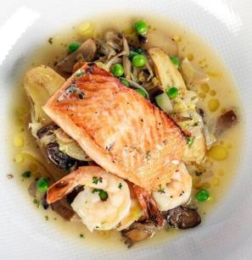
$200 Gift Certificate
https://www.grillandvinewhistler.com/

Slide 14
Vancouver…
2 nights on Gold Floor
https://www.fairmont-waterfront.com/

Slide 15
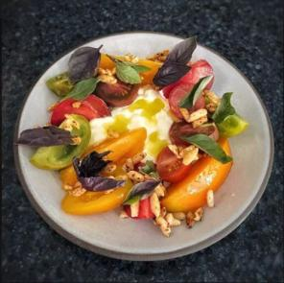
Vancouver…
https://barbararestaurant.com/
$250 Gift Certificate

Slide 16
Vancouver…
$150 Gift Card
TripAdvisor’s #1 Ranked Fine Dining Dinner Restaurant in Vancouver
https://alouettevancouver.com/

Slide 17
The Vancouver / Whistler Experience For 2
2 nights at Fairmont Pacific Rim with Breakfast
Dinner at AnnaLena
Dinner at Burdock & Co.
5 nights at Fairmont Chateau Whistler
Two 5-Day Edge Cards to Whistler/Blackcomb
Full Whistler Sightseeing Tour
Experience at Bearfoot Bistro
Dinner at Wild Blue Restaurant + Bar
Dinner at The Grill Room
Dinner at Araxi Restaurant & Oyster Bar
Dinner at Il Caminetto
Breakfast/Dinner at Grill & Vine Whistler
2 nights at Fairmont Waterfront, Gold Floor
Dinner at Barbara Restaurant
Dinner at Alouette Bistro

