Slide 1
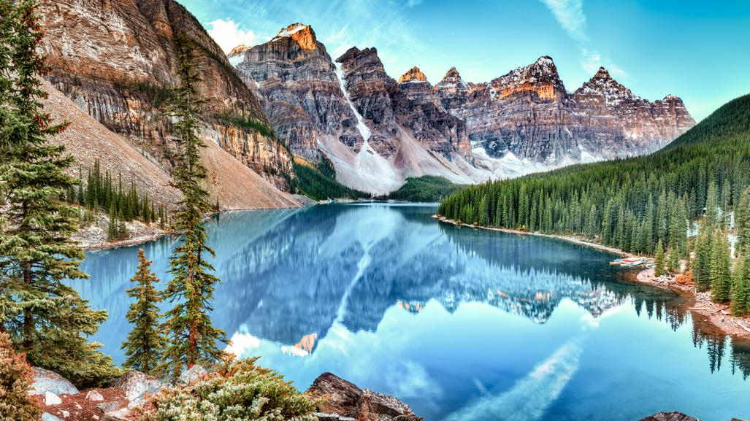
The Ultimate Rocky Mountain Experience For 2

Slide 2
The Ultimate Rocky Mountain Experience For 2
7-day rental of an Intermediate SUV or similar
Pick-up at Calgary Airport / drop-off at Jasper Train Station

Slide 3
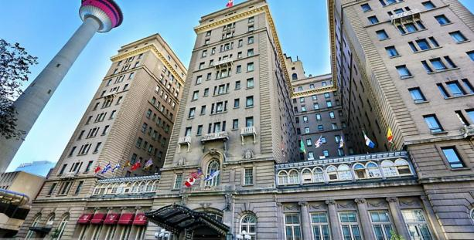
2 Nights + Breakfast
* Not valid during Calgary Stampede Week
https://www.fairmont.com/palliser-calgary/

Slide 4
The Ultimate Rocky Mountain Experience…
Chef’s Tasting Menu for two
https://www.river-cafe.com/

Slide 5
The Ultimate Rocky Mountain Experience…
Dinner for 2: Tasting Menu
with Wine Pairings
Only restaurant in Calgary with AAA 4 Diamond Award in 2023
https://rougecalgary.com/

Slide 6
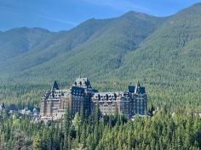
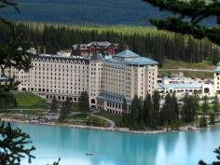
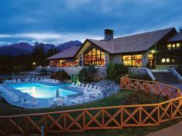
The Ultimate Rocky Mountain Experience For 2
4 nights at your choice at one or more of the following hotels:

Slide 7
The Ultimate Rocky Mountain Experience…
1 of 4 restaurants in Canada with AAA 5 Diamond Award in 2023
https://www.rimrockresort.com/dine-drink/eden/

Slide 8
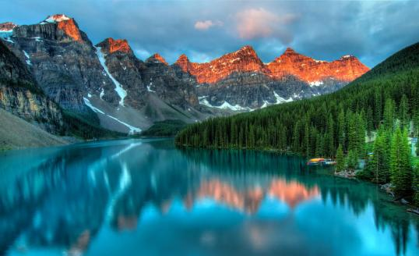
Banff National Park
Explore Canada's first national park and the flagship of the nation’s park system. Rocky Mountain peaks, turquoise glacial lakes, wildlife and a picture-perfect mountain town.
https://parks.canada.ca/pn-np/ab/banff

Slide 9
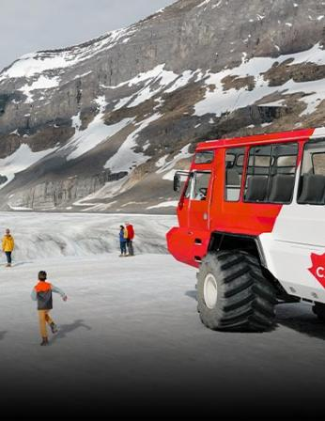
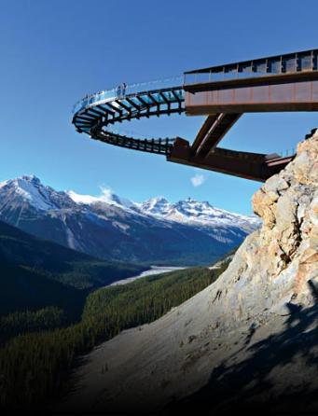
The Ultimate Rocky Mountain Experience…
Book Your Visit Anytime
Banff Gondola
Columbia Icefield Skywalk
Columbia Icefield Adventure
Maligne Lake Cruise
Lake Minnewanka Cruise
Golden Skybridge
Pursuit Pass
Rockies
https://www.banffjaspercollection.com/

Slide 10
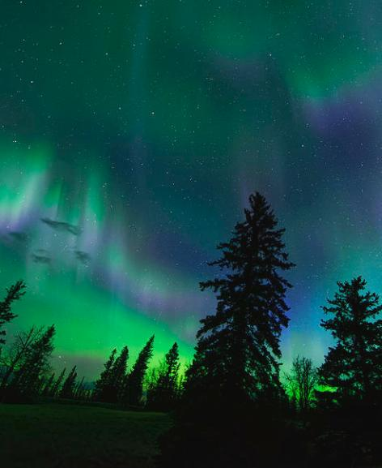
Jasper National Park
Known for its vast wilderness, majestic peaks, abundant wildlife and outstanding natural beauty, visitors from all over Canada and round the world travel here to experience this very special place
https://parks.canada.ca/pn-np/ab/jasper

Slide 11
The Ultimate Rocky Mountain Experience For 2
$150 Gift Cards for both locations
Experience both Banff’s and Jasper’s real mountain lifestyle—day and night—food, drinks, or late night.
https://banffavebrewingco.ca/
https://jasperbrewingco.ca/

Slide 12
The Ultimate Rocky Mountain Experience For 2
Dinner for 2
https://syrahsofjasper.com/

Slide 13
Journey Through The Clouds
https://www.rockymountaineer.com/train-routes/journey-through-clouds
2 days onboard Rocky Mountaineer, 1 night in Kamloops
One-way: begin in Jasper and end in Vancouver

Slide 14
Enjoy GoldLeaf Service travelling through scenic valleys, along the mighty Fraser River, through Hell’s Gate, and past the magnificent Pyramid Falls. This Rocky Mountaineer rail route, only accessible by train,
also features the majestic Mount Robson, the highest peak in the Canadian Rockies.
*Trip MUST be completed in the 2024 season which ends on October 13, 2024

Slide 15
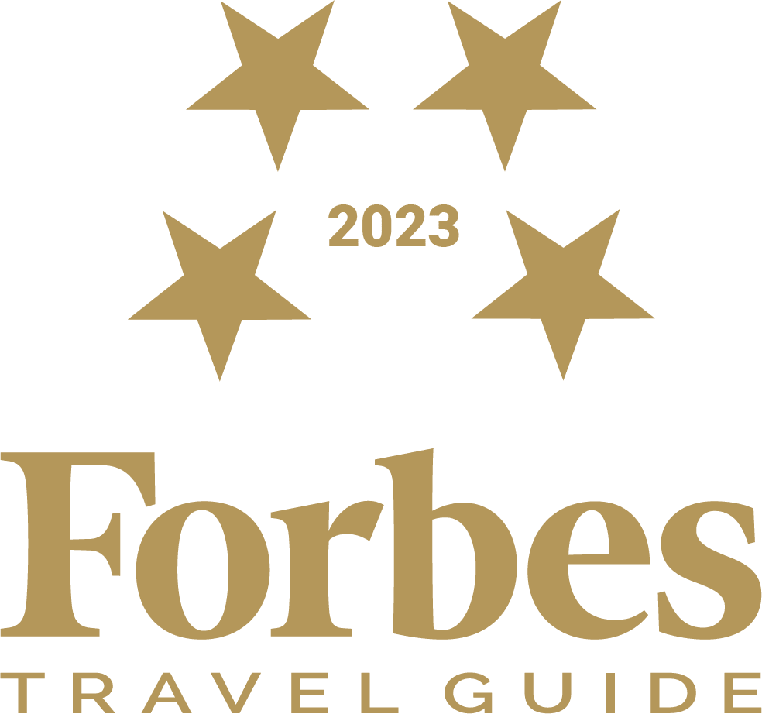
The Ultimate Rocky Mountain…
https://www.fairmont-hotel-vancouver.com/

Slide 16
The Ultimate…
Dinner for 2
https://www.kissatanto.com/

Slide 17
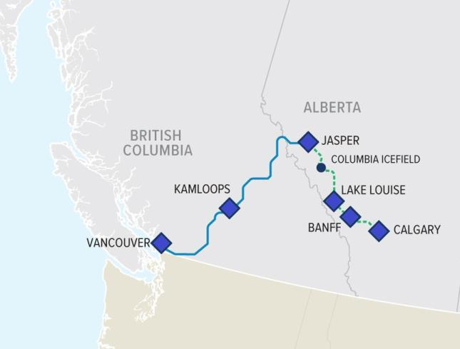
The Ultimate Rocky Mountain Experience For 2
7-day Intermediate SUV Vehicle Rental from Avis
2 nights + breakfast at Fairmont Palliser in Calgary
Tasting menu for 2 at The River Café in Calgary
Tasting menu for 2 + wine pairing at Rouge Restaurant in Calgary
4 nights at CHOICE of either-or combination of:
Fairmont Banff Springs
Fairmont Chateau Lake Louise
Fairmont Jasper Park Lodge
Dinner for 2 at Eden in Banff at Rimrock Resort Hotel
Gift Card to Banff Ave. Brewing Company
Pursuit Pass – Rockies for 2 people
Dinner for 2 at Syrahs of Jasper
Gift Card to Jasper Brewing Company
The Rocky Mountaineer: Jasper to Vancouver
2 nights at Fairmont Hotel Vancouver
Dinner for 2 at Kissa Tanto

