Slide 1
The Maritime Experience For 2

Slide 2
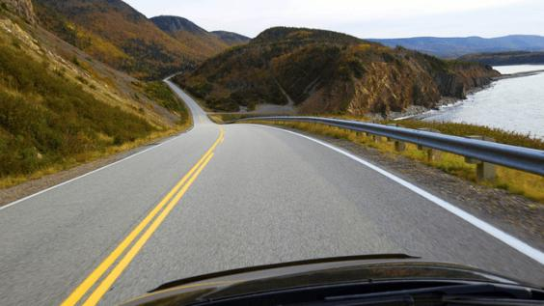
The Maritime Experience…
1-week FREE rental of Mid-Size SUV or Mini-Van

Slide 4
The Maritime Experience…
2-night stay

Slide 5
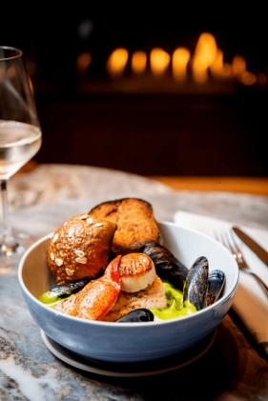
The Maritime Experience…
Three-course dinner for two including
a round of hand-crafted welcome cocktails
https://www.drifthalifax.com/

Slide 6
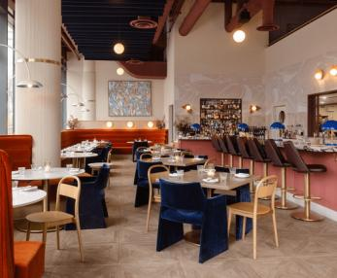
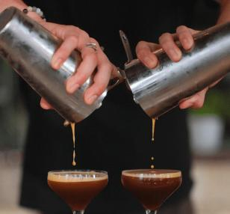
$150 Gift Certificate
https://www.fawnresto.com/

Slide 7
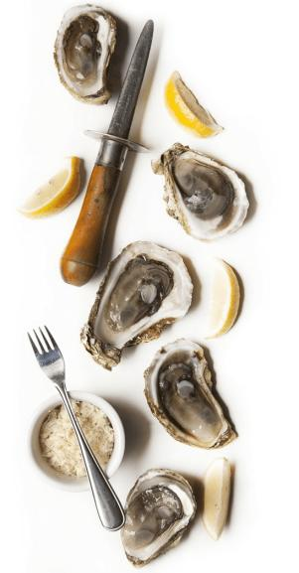
The Maritime Experience…
$200 Gift Certificate
http://www.thepressgang.ca/

Slide 8
Explore all the beauty that the South Shore has to offer from Chester, to Mahone Bay, to Lunenburg and everything in between

Slide 9
The Maritime Experience…
Enjoy a two-night stay in an Oceanview room with a King bed
https://www.oakislandresort.ca/

Slide 10
The Maritime Experience…
Old Town Lunenburg is one of only two urban communities in North America designated as a UNESCO World Heritage site. Considered to be the best surviving planned British colonial town in North America.
https://lincolnstreetfood.ca/
$150 Gift Certificate
#1 Ranked Restaurant in Lunenburg on TripAdvisor

Slide 11
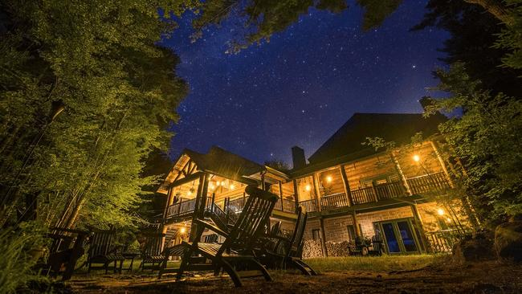
Trout Point Lodge is the world’s first certified Starlight Hotel by the UNESCO partner Starlight Foundation

Slide 12
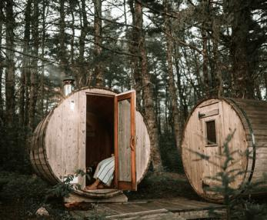
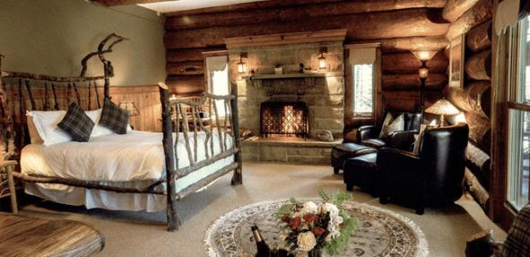
Nova Scotia's Premier Luxury
Wilderness Resort & Hotel
Nestled In UNESCO Southwest Nova Scotia Biosphere Reserve
​New York Times: "Worth a visit no matter what the season"
Forbes: "Intimate and secluded, spending time here feels like being let in on a wonderful and well-kept secret"
National Geographic Society: Trout Point Lodge among "ten of the most innovative, sustainable travel programs around the world"
https://www.troutpoint.com/

Slide 13
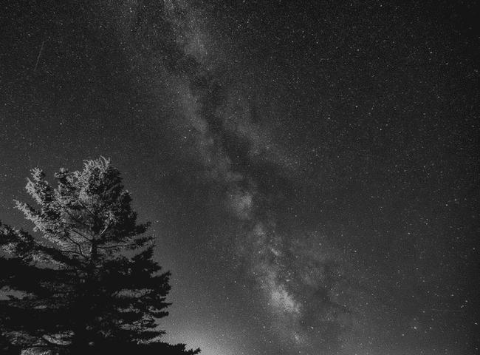
The Maritime Experience…
Enjoy a Two Night Getaway Package for 2 people
Trout Point Lodge in suite of your choice
Gourmet 4-course dinner for two both nights
Luxurious breakfast for two each day
Choice of gourmet packed lunch or lunch in Great Room/Patio on Day 2
Standard cocktails, wines by the glass and beer included
Complimentary guided outdoor activities which include stargazing, forest bathing and more
Unlimited access to all resort facilities such as our wood-fired hot tub by the Tusket River, outdoor barrel sauna, kayaks, canoes and standup paddle boards
Valid until May 31, 2025

Slide 14
The Maritime Experience…
The Maritime Experience…

Slide 15
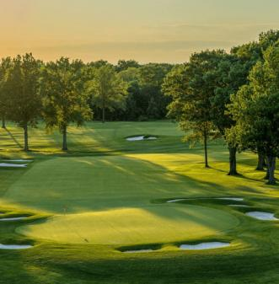
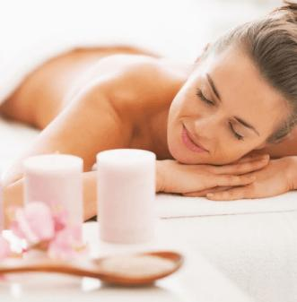
Beautifully situated overlooking the Annapolis Basin and picturesque town of Digby—the “Scallop Capital of the World”—the resort offers a refreshing coastal escape.
Enjoy a 2-night accommodation with breakfast for 2*
https://www.digbypines.ca/
*excluding Friday and Saturday nights in July and August 2024

Slide 16
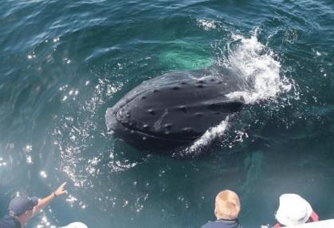
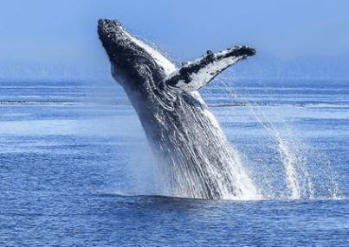
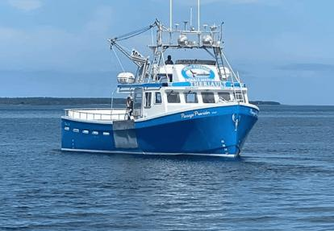
Enjoy two adult fares
A Destination Canada bucket list experience!
Bay of Fundy is an eco-attraction on par with such marvels as the Great Barrier Reef of Australia and the Rain Forest of Brazil. Its mighty tides are the greatest on earth. Every day, twice daily, one hundred billion tons of seawater roll in and out of the Bay.
Every summer whales of all sizes (up to 15 species) come to the Bay of Fundy, to mate, play and feast on the bountiful supply of food churned up by the powerful tides.
https://ppww.ca/

Slide 17
Annapolis Valley - Land of Orchards, Vineyards, and Tides

Slide 18
One night in new Executive Suite
Kitchenette
Living room
2-sided water vapour fireplace
Guest bathroom
Full bathroom in the sleeping area.
https://oldorchardinn.com/

Slide 19
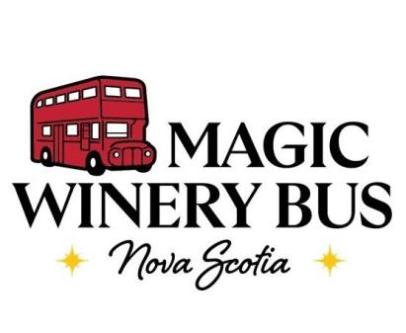
A Destination Canada bucket list experience!
Incredible wineries with unforgettable experiences in the Annapolis Valley
Visit Four Wineries - Wine Tastings Included
https://magicwinerybus.ca/

Slide 20
The Maritime Experience…
$100 Gift Certificate
https://lightfootandwolfville.com/

Slide 21
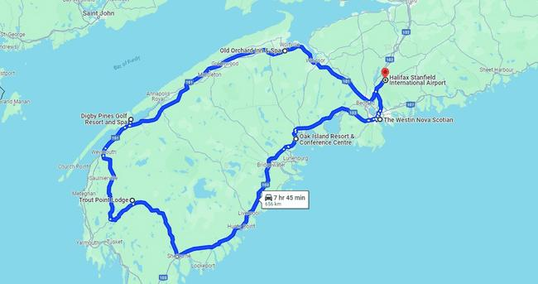

Slide 22
The Maritime Experience for 2
One week vehicle rental from Enterprise Rent-A-Car
Two nights at The Westin Nova Scotian in Halifax
Dinner at Drift Restaurant
Lunch at Fawn Restaurant
Dinner at The Press Gang & Oyster Bar
Two nights at Oak Island Resort and Conference Centre
Dinner at Lincoln Street Food, Lunenburg
Two nights at Trout Point Lodge, including food and beverage
Two nights at Digby Pines Golf Resort and Spa
Petit Passage Whale Watching
One night at Old Orchard Inn & Spa in Wolfville
Magic Winery Bus Tour
Meal at Lightfoot & Wolfville Winery

