Slide 1
The Caribbean Experience

Slide 2
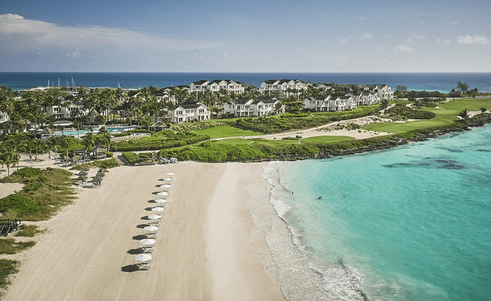
https://grandisleresort.com/

Slide 3
Welcome to the Grand Isle Resort & Residences
Peter Nicholson, the President and Founder of The Foundation WCPD, is pleased to donate a one-week stay in a two-bedroom villa at the luxurious Grand Isle Resort & Residences in Exuma, The Bahamas.
Grand Isle, a former Four Seasons Residences, is just steps from Emerald Bay Beach, one of the finest in the Caribbean.
Known for catering to some of the world’s wealthiest jetsetters, Grand Isle Resort provides guests with the finest amenities and unparalleled service.
Meanwhile, this community is your getaway to the exotic Exuma Cays, a collection of 365 islands boasting the clearest, most pristine water in the world, and world-famous attractions such as the swimming pigs, giant iguanas, celebrity islands and stunning sandbars.
This prize gives you access to a beautiful two-bedroom villa averaging 2,315 square feet on two levels. The spacious villa has a living room with access to a private balcony, a fully appointed gourmet kitchen with granite countertops, a dining room, powder room, natural stone flooring and custom-designed furnishings.
*PACKAGE DOES NOT INCLUDE the cost of activities, food & beverage, daily housekeeping and a one-time exit cleaning fee of approx. $237 USD. This offer EXPIRES on May 1st, 2025. RESERVATIONS are based on AVAILABILITY and subject to resort BLACKOUT DATES (major holidays)

Slide 4
The Caribbean Experience
One-week stay in Luxury Ocean-View Villa in Exuma, The Bahamas
Steps away from the famous Emerald Bay Beach
Two-bedroom villa, 2,315 sq. ft on two levels
Exquisite interior design & plush furnishings
Central Air-conditioning
50-inch plasma TV with cable television
Sub-Zero refrigerator, oven, stovetop, dishwasher & full-size washer and dryer
High speed wireless internet
Concierge service
Kindly donated by Peter Nicholson, the President & Founder of The Foundation WCPD

