Slide 1
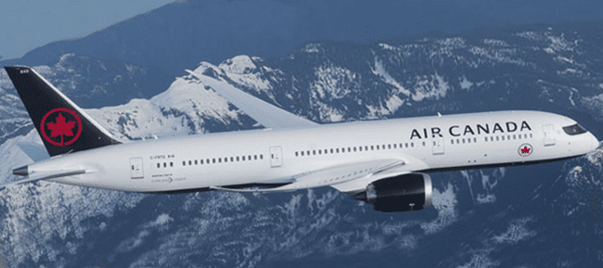
Two round trip Business Class tickets to any scheduled Air Canada destination
Air Canada averages more than 1,600 flights per day, travelling to 62 Canadian cities, 53 destinations in the United States and 100 cities in Europe, the Middle East, Asia, Australia, the Caribbean, Mexico and South America. You could go anywhere travelling in comfort and style.
Where would you go?

Slide 3
